Slide 1

ॐ अमनाय स्तुतये रुद्राय नमः

Slide 2

AMNAYA©
‘Higher Perception is Intelligence’
19 W STE 1018 34TH STREET, NEW YORK CITY, NY-US
projects@amnayacorp.com / www.amnaya.us / www.amnaya.in
+1-646-599-0344(US)/ +1 646-513-4151(US)/ +44-20-7660-1491(UK)/ +91-9621-546-781(INDIA)

Slide 3

WHAT ARE THE BROAD DELIVERABLES FROM VENDOR?
WHAT DO WE PROPOSE TO DO? – SETUP A UNIT FOR CLIENT AS UNDER:
PHASE I | Goat Cheese Manufacturing Plant for XXXX Liters Per Day
Phase II | Goat Cheese Manufacturing Plant for XXXX Liters of Goat Milk Per Day; Goat Farm Setup for XXXX of Requirements of Goat Milk Per Day
Phase III | Unit is integrated within AMNAYA Global Value Chain for Dairy Products, Unit is commissioned as a 100% EOU
Business Setup and Execution, Business Development & Supply Chain Management
WHAT IS AMNAYA’s PREFERRED MODE OF ASSOCIATION?
Retained for Each of the Phase and Each set of the Deliverables; Taxation as per Local Jurisdiction(ex. Indian Tax Laws applicable for those hired within India)

Slide 4
PHASE-1
Setting up of Goat Cheese Manufacturing Plant for a Total Capacity
of XXXX Liters per day basis.
Sales of ‘ALL’ Manufactured Cheese from Day 1 Onwards
Operational Efficiency based upon Pooling in of Revenues for Re-Investment
Enablement of an Automation Plant – Planned and Proposed.
Resource Planning and Scheduling of Activities will require Additional
Trust, Accountability and Transparency

Slide 5
PHASE-I1
Setting up of Goat Cheese Manufacturing Plant and Goat Farm
Facility for an ‘Additional’ Capacity of XXXX Liters per day basis.
Sales of ‘ALL’ Manufactured Cheese on Continued basis
Operational Efficiency based on Pooling in of Revenues for Re-Investment
Enablement of an Automation Plant – Planned and Proposed to be
Initiated Month# onwards
Use case for Blockchain and additional deployment of Technology space for
Trust, Accountability and Transparency

Slide 6
PHASE-II1
Inclusion of the Unit under the AMNAYA Global Value Chain for Dairy Products – Blockchain and AI enabled Platform for Exports of Goat Cheese and Camel Milk based Cosmetics
Branding of the Unit under an Australian based Renowned Brand name for Manufacturing and Sales of Goat Cheese
Modulation of the Unit as 100% Export Oriented Unit(EOU) for Sale of Goat Cheese

Slide 7
How well do we know Goat Cheese and Camel Milk based Cosmetics?

Slide 8











TRACEABILITY UNDER AMNAYA GLOBAL VALUE CHAIN FOR DAIRY PRODUCTS: GOAT CHEESE
AMNAYA
Producer
Processor
Processed
Transport
Store
Producer enters data onto the blockchain
Data and time of arrival/
processing/ shipping, processing method, etc. entered into the blockchain
Sensors continuously transmit data to the blockchain about time, location, condition
Consumer flashes the smart tag and accesses all supply chain history
BLOCKCHAIN
Physical
Digital

Slide 9
















GLOBAL VALUE CHAIN FOR DAIRY PRODUCTS – GOAT CHEESE
AMNAYA
Goat Milk
Manufacturer
Cheese Production
Silos
AMNAYA
Global Centre for Blockchain and AI
Analytics
Data Warehouse
AMNAYA INDIA
AMNAYA UK
Organized Retail
Exported
Quality Audit
Quality Verification
Information Access
Information Sharing
AMNAYA AUSTRALIA

Slide 10






HOW DOES GLOBAL VALUE CHAIN FOR DAIRY PRODUCTS WORK?
AMNAYA
AUSTRALIA
AMNAYA INDIA - Goat cheese and camel milk based cosmetics, both are manufactured in India.
AMNAYA UK - Global Centre for Blockchain and AI creates and runs the platform to manage GVC-D.
AMNAYA AUSTRALIA – Liaison with Brands of Goat Cheese and Camel Milk based Cosmetics. Royalty based agreement for use of technology and brand/Trademark.
GLOBAL VALUE CHAIN FOR DAIRY PRODUCTS
UNITED KINGDOM
AMNAYA INDIA – Network of Goat Cheese Producers and Camel Cooperatives, manufacturing facilities.
AMNAYA UK – AMNAYA Centre of Excellence - Global Centre for Blockchain and AI.
AMNAYA AUSTRALIA – Australian partners to develop liaison with Australian companies and supply chain networks.
INDIA

Slide 11
BLOCKCHAIN AND ARITIFICIAL INTELLIGENCE ENABLED PLATFORM FOR
GLOBAL VALUE CHAIN –DAIRY

Slide 12
TRACEABILITY UNDER AMNAYA GLOBAL VALUE CHAIN FOR DAIRY PRODUCTS: GOAT CHEESE
AMNAYA
Producer
Processor
Processed
Transport
Store
Producer enters data onto the blockchain
Data and time of arrival/
processing/ shipping, processing method, etc. entered into the blockchain
Sensors continuously transmit data to the blockchain about time, location, condition
Consumer flashes the smart tag and accesses all supply chain history
BLOCKCHAIN
Physical
Digital

Slide 13











FRAGMENTED TRADITIONAL TRADE FINANCE PROCESS ACROSS ENTITIES/PROCESSES
AMNAYA
3
16
12
Invoicing Platform
Document Courier
15
11
Document Courier
Import Customs
13
Export Customs
9
7
1
14
10
1
Importer
Import Terminal
Shipper
Export Terminal
Exporter
4
6
5
Importer’s Bank
Exporter’s Bank
17
Interbank Messaging
Physical shipment of goods
Correspondent Bank
Financing
Transfer of instructions and documents
Payment
Risk mitigation and compliance

Slide 14






TYPICAL INTERNATIONAL TRADE DOCUMENTATIONS ISSUED
AMNAYA
!
!
!
!
!
!
!
!
!
!
!
Exporter
i.e. Shipper
Exporter’s Bank/
Insurer
Export
Customs
Forwarder
Export Port
Carrier
Import Port
Importer’s Bank/
Insurer
Importer Consignee
TYPICAL DOCUMENTATIONS ISSUED
Sales Contract
And Trade Terms
Letter of Credit
Certification of
Origin
House Bill of Lading/
House Airway Bill
Port Declaration
Customs Clearance
Letter of Credit/
Procession
Insurance Policy
Manifest
Import licenses/
Certificates
Commercial Policy
Invoices
Customs Value
Declaration
Shipment Status:
Booking confirmation,
Arrival Notification
Shipment Status
Purchase Order
Packing List
Export Licenses
Certificate

Slide 15
PROCESSES INVOLVED IN CROSS BORDER TRADE TRANSACTIONS
AMNAYA
COMMERCIAL TRANSACTIONS/TRADE FINANCING/OFFICIAL CONTROL MEASURES/TRANSPORT
Commercial Transaction
- Exporter/Importer
(offer, purchase order, invoice, etc.
Trade Financing
- Banks(LC, Bill of Exchange, etc.
Transport
Logistics providers
(bill of lading, insurance policy, etc.
Official Control Measures
- Ministries, Customs, etc.
(SPS Certificate, Conformity Certificate, Certificate of Origin, Import/Export License

Slide 16




LETTER OF CREDIT
AMNAYA
TRADITIONAL MODEL
BLOCKCHAIN MODEL
Importer
Exporter
Importer
Exporter
Sales Contract
Shipment
Permissioned Distributed Ledger
Hashed/Encrypted documents Smart Contracts to automate payments
Documents and
Claim Payment
Request Letter of Credit(LC)
Deliver LC
Present Documents
Importer’s bank issues LC
Document control,
Release of payment at maturity
Importer’s Bank
Present Documents
Exporter’s Bank
Importer’s Bank
Exporter’s Bank

Slide 17
CROSS BORDER G2G SCENARIOS-
AMNAYA
SCENARIO#1
SCENARIO#2
Country A
Country B
Country A
Country B
CROSS BORDER, SINGLE BLOCKCHAIN
BLOCKCHAIN
TECHNOLOGY A
BLOCKCHAIN
TECHNOLOGY B
No Operability Needed
Intra-ledger Interoperability Needed
SCENARIO#4
SCENARIO#3
Country A
Country B
Country A
Country B
Off-Chain
Mode
Off-Chain
Mode
BLOCKCHAIN
TECHNOLOGY A
BLOCKCHAIN
TECHNOLOGY A
API Connection
API Connection
Intra-ledger Interoperability Needed
BLOCKCHAIN BASED TRADE PLATFORM

Slide 18
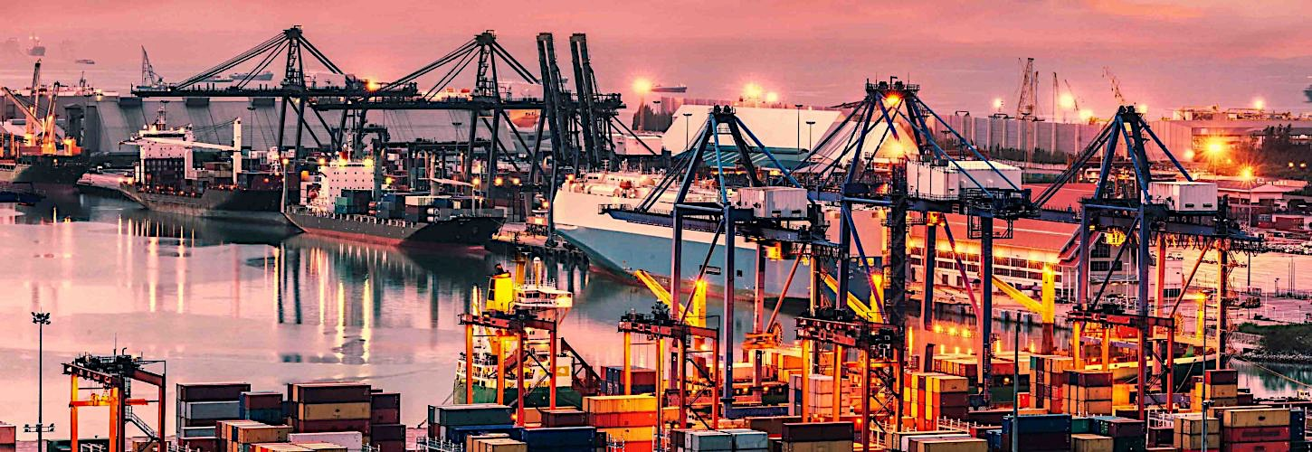
AMNAYA
AMNAYA TRADE DIGITALIZATION PROJECT

Slide 19





AMNAYA TRADE DIGITALIZATION PROJECT
AMNAYA
GLOBAL TRADE DIGITALIZATION
Authority
Consignee
Exporter
Authority
Authority
Forwarders
Exporter
Rail
Forwarders
Consignee
Trucker
Terminal
Authority
Authority
Carrier
Authority
Terminal
Authority
Carrier
TODAY
FUTURE
Exporters
Freight Forwarders
Ports and Terminals
Ocean Carriers
Authorities
Inland Transportation
Importers
Logistics Actors
Internal Systems
Port Community Systems Terminal Operating System
Customs System
Supply Chain Visibility System
Supply Chain/ Transportation
Management System
OPEN PLATFORM

Slide 20

CORRESPONDENT BANKING SYSTEM
AMNAYA
Payer
Payment
System
Payment
System
Payee
Payer’s Bank
(Transaction Fee)
Payee’s Bank
(Transaction Fee)
Correspondent Bank A
Correspondent Banking Fee
Correspondent Bank B
Correspondent Banking Fee
and FX Conversion Fee
MESSAGING INFRASTRUCTURE

Slide 21







Date of Order
Date of Invoice
Date of Shipment
Date of Settlement
Date of Bill of Lading/Airway Bill
Latest Date of Shipment under LC
Expiry Date of LC
Location of LC Presentment
Period of Presentation of Document
LC Sequences for Total Ref#
Sending/Applicant Bank
Receiving/Advising Bank
Importers/Buyers/ LC Applicant
Exporter/Seller/LC Beneficiary
Address of Importer/Buyer
Address of Exporter/Seller
Country Code and Amount of LC
Percentage of LC Amount Tolerance
Maximum Credit Amount
Additional Amounts Covered
Bank here Credit is Available
Terns/.Drafts(from Bill of Lading Date)
Drawer of Drafts(Bank)
Documents Required
Additional Conditions of LC
Charges with Currency Code and Amount
LC Confirmation and Instructions
Reimbursing/ Correspondent Bank
Instructions to Pay/ Accepting Bank
Invoice Amount
Invoice Number
Account Information
Letter of Credit Number
Form of Documentation Credit
Applicable Rules
Reference to Pre-Advise LC
Commercial Invoice Number
Insurance Policy Advisor
Purchase Order Number
Certificate of Origin Reference Number
Stock Keeping Order#
Design Name
Description of goods,
Color
Quantity
Unit Price
Gross Weight
Net Weight
Measurement
Number of Packages
Packing Type
Means of Transport and Route
Carrier/Shipper
Ocean Level
Voyage Number
Port of Lading/ Port of Departure
Port of Discharge/Airport of Discharge
Origin Criterion
Final Destination
Partial Shipment Allowed/ Not Allowed
Trans-Shipment Allowed/Not Allowed
Insurance Providers
Coverages
Credit Limit
Effective Date
LC Authorization
Export Representative to sign Bill of Exchange
Export Representative to sign Commercial Invoice
Validate Certificate of Insurance
Validate Certificate of Origin
Agent’s Initial on Bill of Lading
AMNAYA’S FOCUS ON CORRESPONDENT BANKING SYSTEM FOR GVC-D
AMNAYA
Player
Importer
Exporter
Importer’s
Bank
Exporter’s
Bank
Freight
Forwarders
Insurer
Pre-Shipment
Inspector
Export
Customs
Document
Courier
Shipper
Import Customs/
Document Courier
Correspondent
Bank
Letter of Credit
Insurance Policy
Certificate of Origin
Payment Confirmation
Bill of Exchange
Commercial Invoices
Order Form
Bill of Lading
Weight/Packing List
KYC/AML/Sanction
Document
Data Element

Slide 22
HOW DOES GLOBAL VALUE CHAIN FOR DAIRY PRODUCTS WORK?
AMNAYA
AUSTRALIA
AMNAYA INDIA - Goat cheese and camel milk based cosmetics, both are manufactured in India.
AMNAYA UK - Global Centre for Blockchain and AI creates and runs the platform to manage GVC-D.
AMNAYA AUSTRALIA – Liaison with Brands of Goat Cheese and Camel Milk based Cosmetics. Royalty based agreement for use of technology and brand/Trademark.
GLOBAL VALUE CHAIN FOR DAIRY PRODUCTS
UNITED KINGDOM
AMNAYA INDIA – Network of Goat Cheese Producers and Camel Cooperatives, manufacturing facilities.
AMNAYA UK – AMNAYA Centre of Excellence - Global Centre for Blockchain and AI.
AMNAYA AUSTRALIA – Australian partners to develop liaison with Australian companies and supply chain networks.
INDIA

Slide 23
GLOBAL VALUE CHAIN FOR DAIRY PRODUCTS – GOAT CHEESE
AMNAYA
Goat Milk
Manufacturer
Cheese Production
Silos
AMNAYA
Global Centre for Blockchain and AI
Analytics
Data Warehouse
AMNAYA INDIA
AMNAYA UK
Organized Retail
Exported
Quality Audit
Quality Verification
Information Access
Information Sharing
AMNAYA AUSTRALIA

Slide 24
How well do we know goat cheese and camel milk based cosmetics?

Slide 25
2014 Outbreak of B. Melitemis in Goat Cheese from Mexico….
Nation Wide Impact
Country Wide Recall
Impact on the Industry
127 cases reported for B. melitemis - most common form of brucellosis in Texas and California. Consumption of unpasteurized goat milk products from Mexico. Survive in goat cheese products for up to 100days.
6 – 7 years to recover
….due to
1 Supplier
1 Lot
1 Day
Recall of Goat Cheese Packs from at least 23,000 stores nationwide
Recall

Slide 26
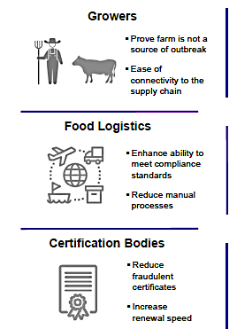
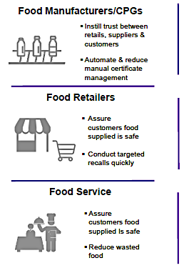
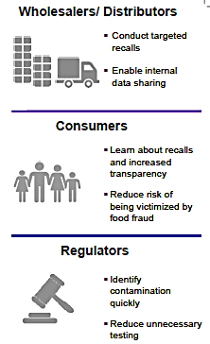
AMNAYA GVCD provides Value to the Entire Chain of Operations from
Point of Production(PoP) to Point of Final Consumption(PoFC)

Slide 27
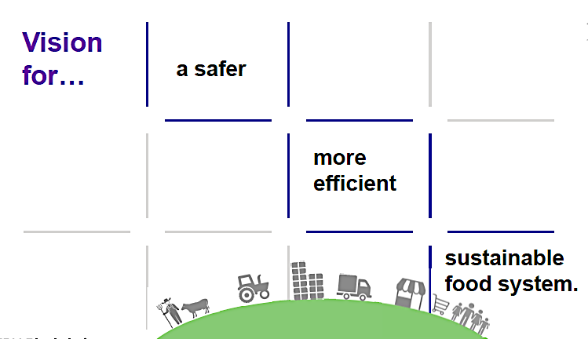

Slide 28
Reachout to projects@amnayacorp.com for all queries related to business and investments.
Thank you!

Slide 30
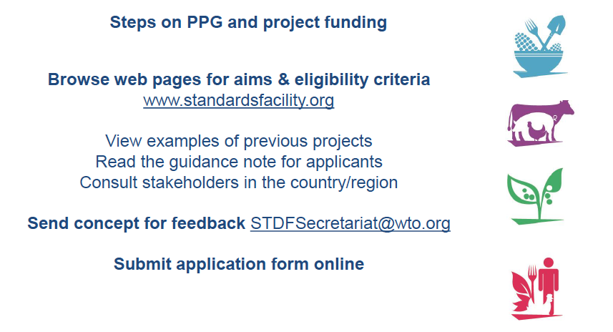
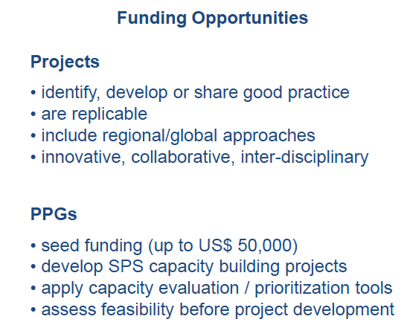
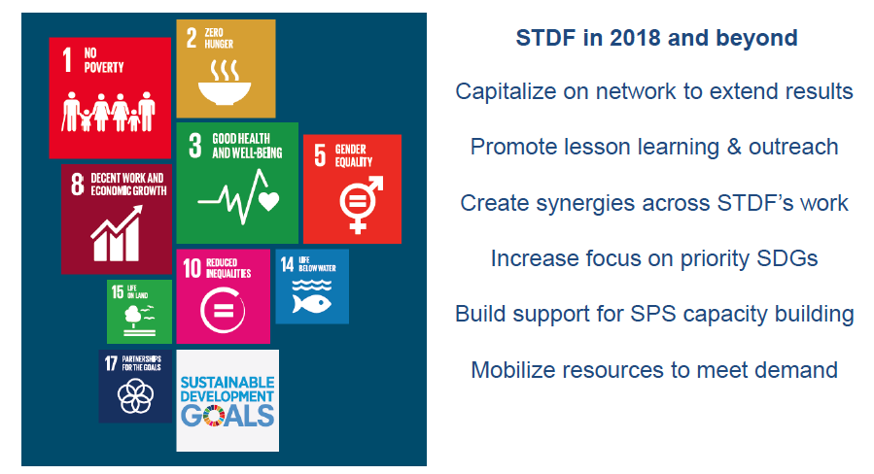
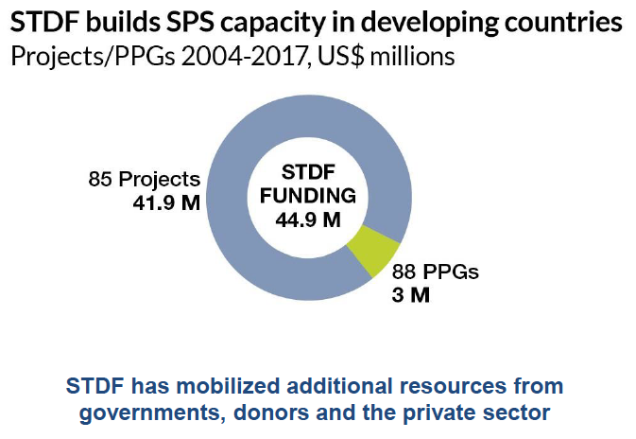

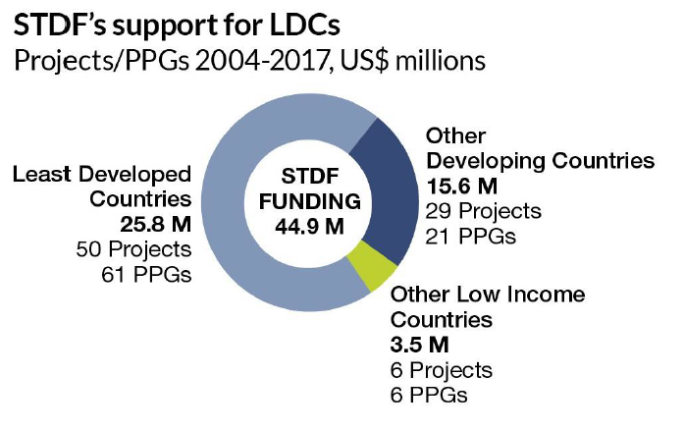
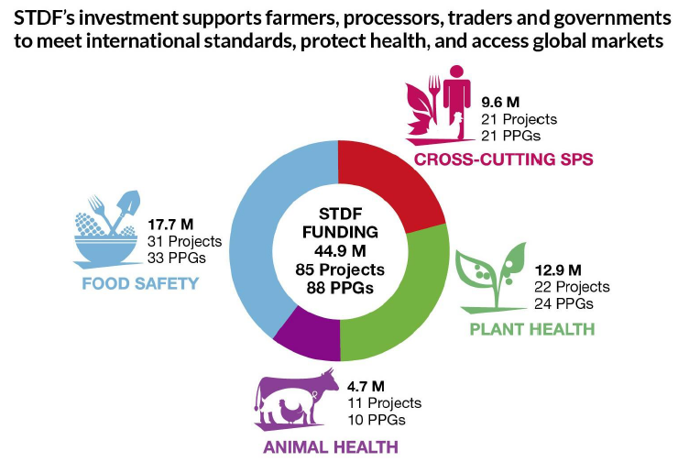


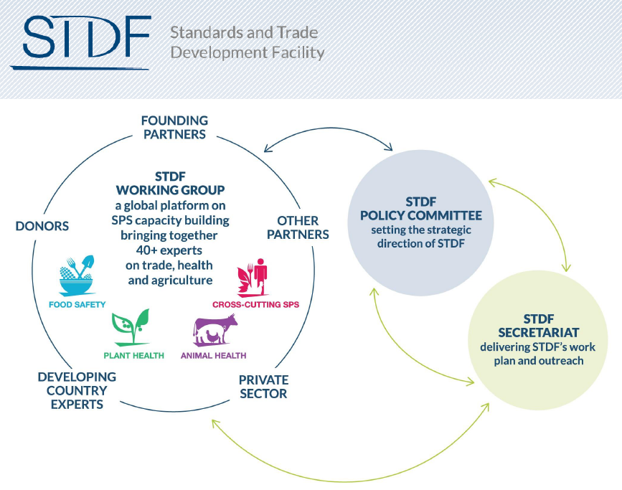

Standard Trade and Development Facility

Slide 31
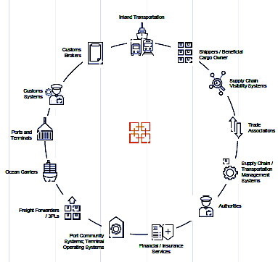

Slide 32
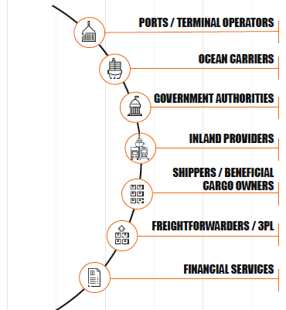

Slide 33
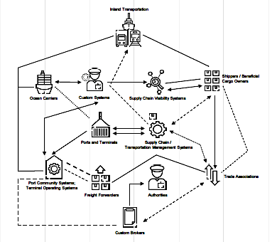

Slide 34
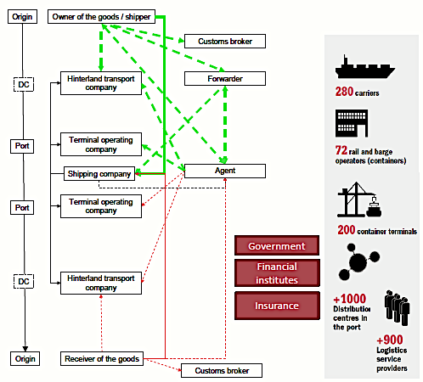

Slide 36
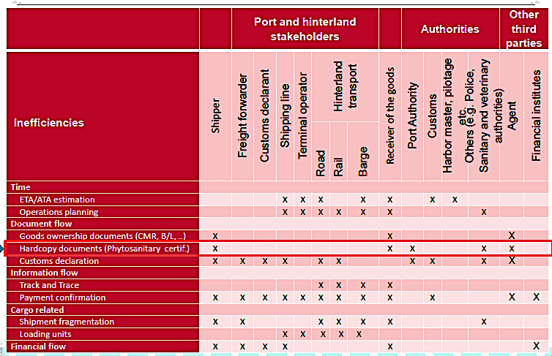

Slide 110
AMNAYA©
‘Higher Perception is Intelligence’
19 W STE 1018 34TH STREET, NEW YORK CITY, NY-US
projects@amnayacorp.com / www.amnaya.us / www.amnaya.in
+1-646-599-0344(US)/ +1 646-513-4151(US)/ +44-20-7660-1491(UK)/ +91-9621-546-781(INDIA)

